Slide 1
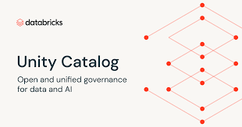
Unity Catalog

Slide 2
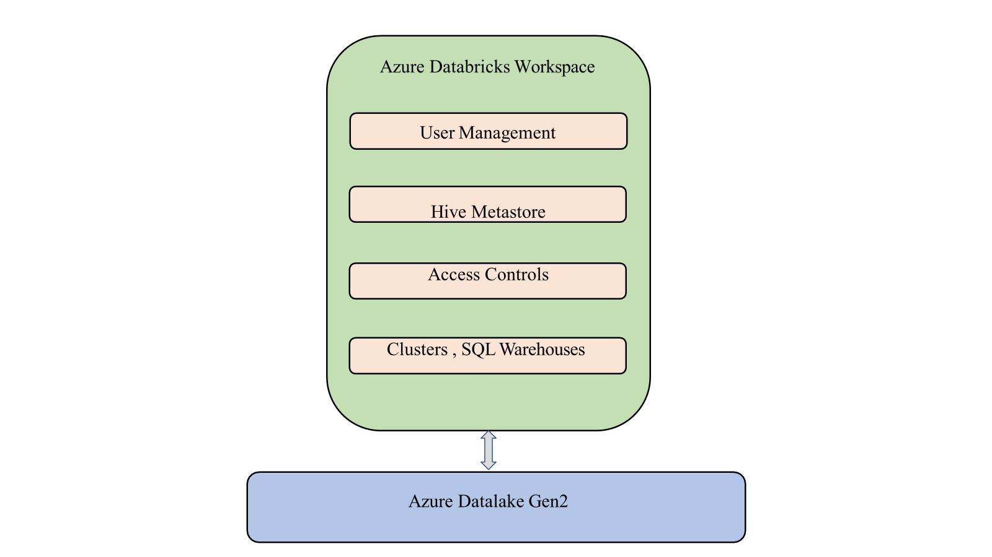

Slide 3
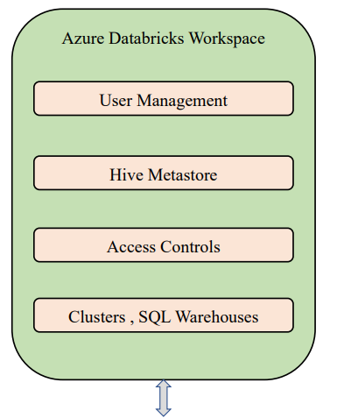
Azure data lake gen 2

Slide 4
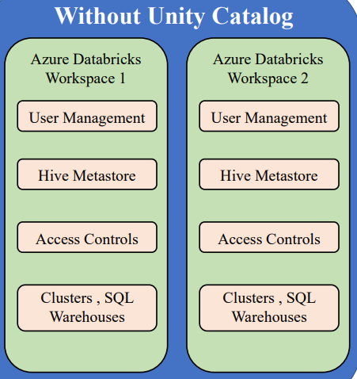
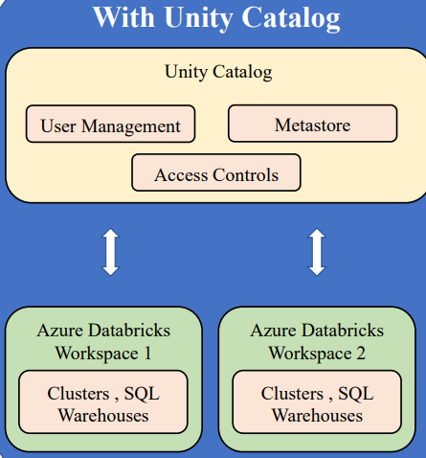

Slide 5
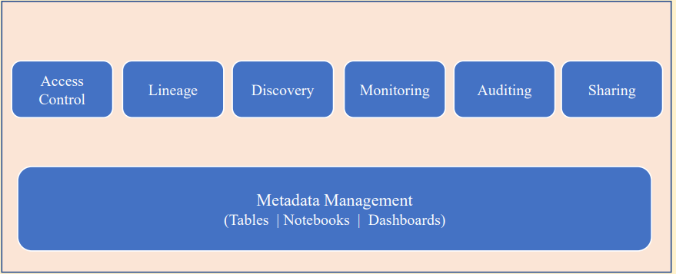
Governance

Slide 6
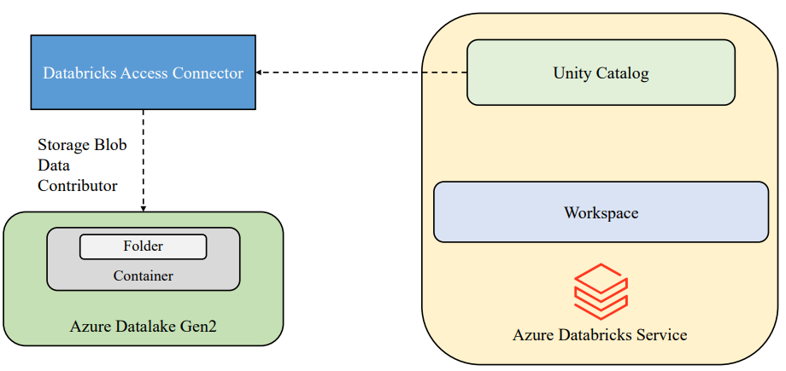

Slide 7
Prerequisite to create the Unity Catelog

Slide 8
till now we have created some managed identity where that is going to give us the access to Azure Data Lake storage. We created that to use the unity catalog. There are some prerequisites you need to meet to use the unity catalog.
You need to have a Databricks Premium workspace.
So while creating this particular workspace in the environment setup section, we created a premium workspace so that we can use the unity catalog on top of it. You need to configure the Metastore.

Slide 9
And the reason why we have created this particular access connector is to configure the Metastore. So while configuring the Metastore, it will ask us the place where it can store the managed tables.
Enable the access to the managed identity. So you can use that to enable this Metastore. And we'll see what exactly is this in this video.
Now after creating the Metastore you need to attach a workspace. That workspace should be premium workspace.

Slide 10
In order to enable the Unity catalog to any workspace or to use the unity catalog, first you need to start with creating a meta store.
Meta Store is a top level container in the unity catalog. And we'll see what exactly are those terminologies in the later sections.
First in order to enable this you need to go to the manage account. This is a particular account management portal where this can be accessed only by the account admins. By default whoever creates this Databricks service will be an account admin.

Slide 11
This is a central place where you can create the meta stores and attach the workspaces. And this can be only done by the account admins. You can click on this particular data (Catalog).
If you can see there is something called create meta store. Before creating that, you can see something called a meta store is a top level container for data in unity catalog within the meta store, Unity catalog provides a three level namespace organizing catalog schemas and tables.

Slide 12
Steps
To create the metastore first generate the new user
Click on the Entra ID
Use the same user to logged in to Azure credential to login to azure and create the databrick, storage account.
To create the metastore login into azure account using new user
Account Console - Databricks

Slide 13
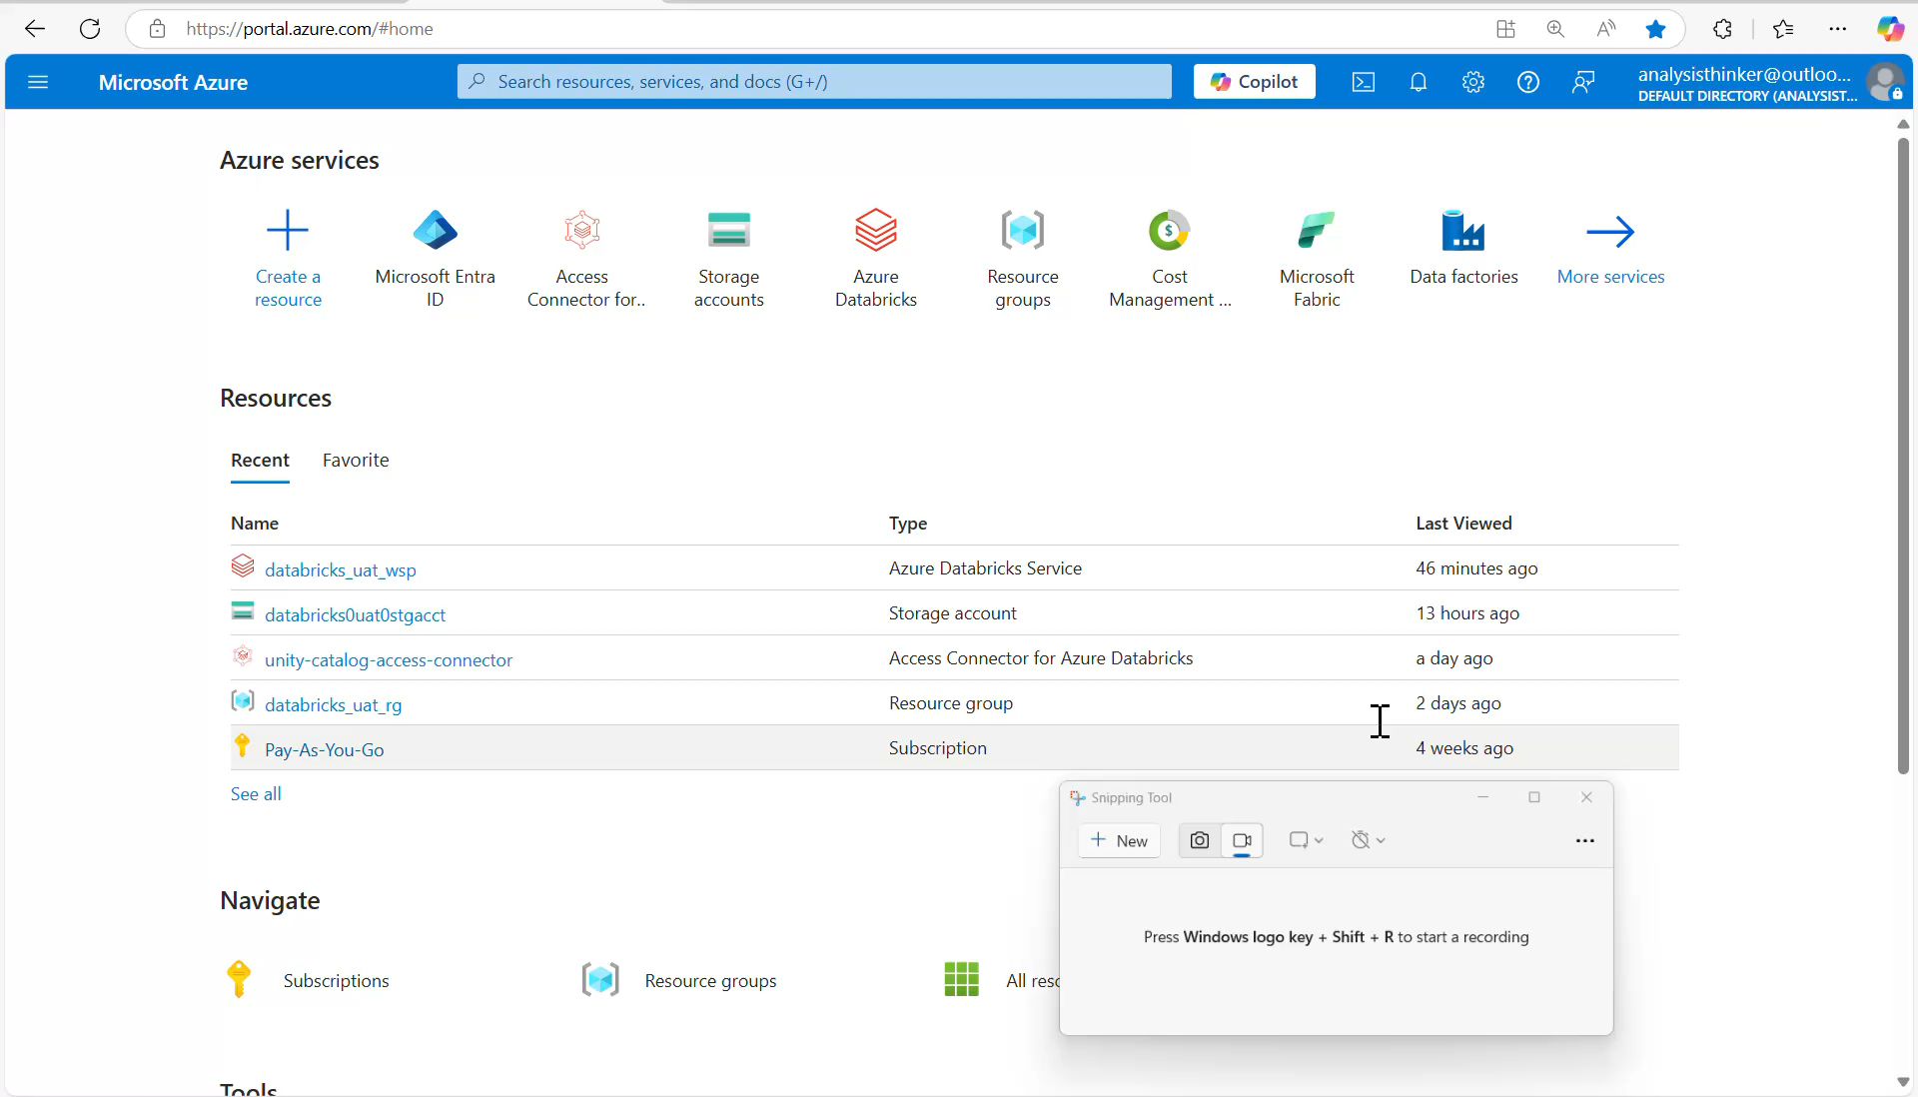

Slide 15
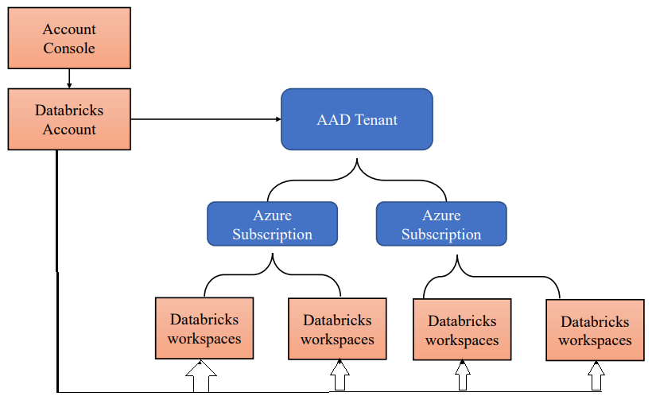
Unity catalog and Azure

Slide 16
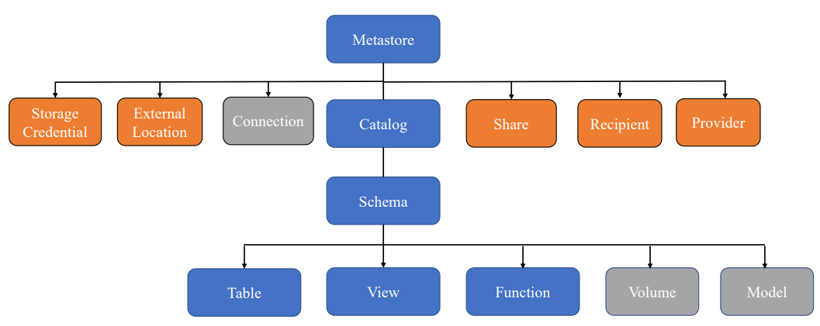
Unity catalog object model

Slide 17
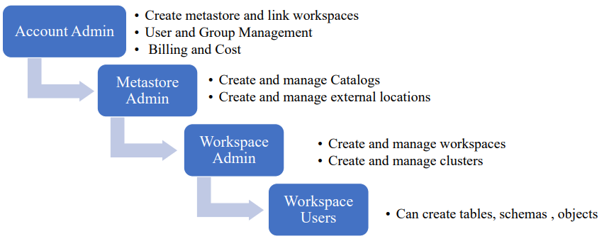
Roles in Unity Catalog

Slide 18
User and Group Management
Invite and add users to Unity Catalog
Create groups
Workspace admins
Developers
Assign groups to users
Workspace admins – Jarvis
Developers - Steve
Assign roles to groups
Workspace Admin – Workspace Admins Group •
Workspace User – Developers Group

Slide 19
Cluster policies
To control user’s ability to configure clusters based on a set of rules.
These rules specify which attributes or attribute values can be used during cluster creation.
Cluster policies have ACLs that limit their use to specific users and groups.
A user who has unrestricted cluster create permission can select the Unrestricted policy and create fully-configurable clusters.

Slide 20
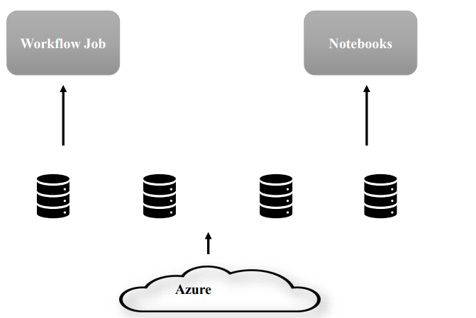
Without cluster pools

Slide 21
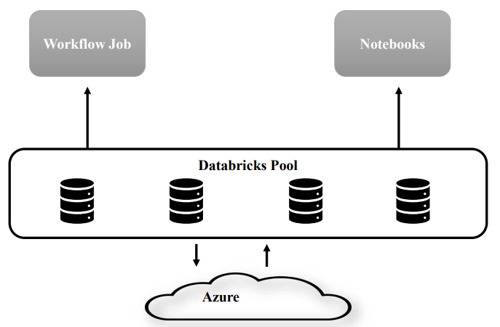
With cluster pools

Slide 22
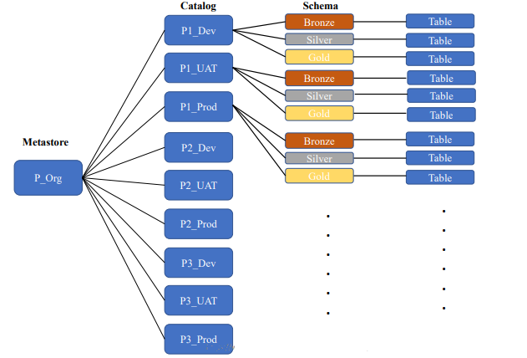

Slide 23
Unity Catalog Privileges
Privileges are permissions that we assign on objects to users
Can use SQL command or Unity Catalog UI
Eg: GRANT privilege_type ON securable_object TO principal
Privilege_Type : Unity Catalog permissions like SELECT, CREATE
Securable_object: Any object like SCHEMA, TABLE , etc
Principal: Can be a user, group, etc

Slide 24
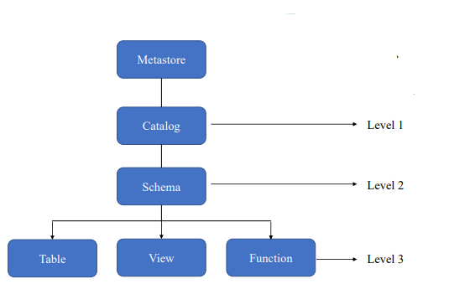
Unity Catalog - Three level Namespace
Select * from catalog.schema.table
Select * from s_dev.sales.products

Slide 25
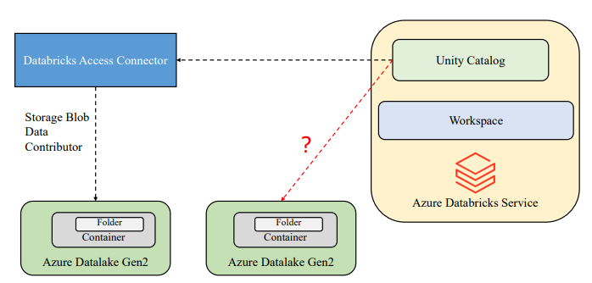

Slide 26
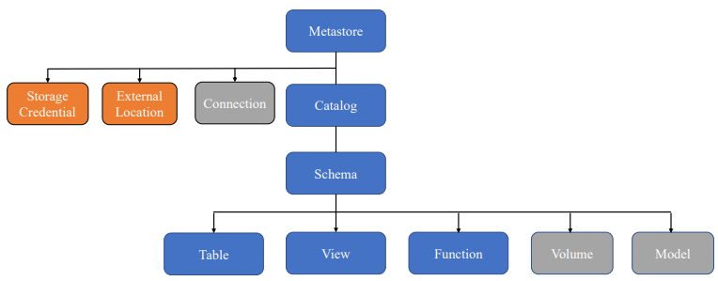
Unity Catalog Object Model

Slide 27
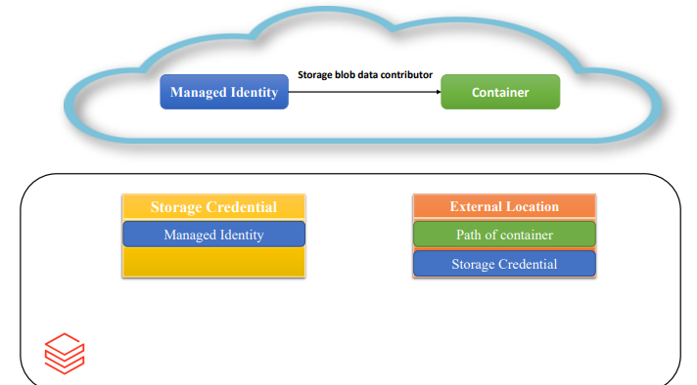

Slide 28
Storage Credentials | External Location
An authentication and authorization mechanism for accessing data stored | Serves as a reference point for External storage
Stores the access Credentials to provide access to External Location | Stores the path of the external storages that you want to access.
Credentials can be Managed Identities / Service principles | Makes use of Storage credential to get access to External Storage

Slide 29
Managed tables
These can be defined without a specified location
The data files are stored within managed storage in Delta format
Dropping the table not only removes its metadata from the catalog, but also deletes the actual data but in Unity Catalog the underlying data will be present for 30 days. •

Slide 30
External Table
You need to have an EXTERNAL LOCATION and STORAGE CREDENTIALS created to access the external storage.
These can be defined for a custom file location, other than the managed storage
Dropping the table deletes the metadata from the catalog, but doesn't affect the data files.

Slide 31
Practical

Slide 32
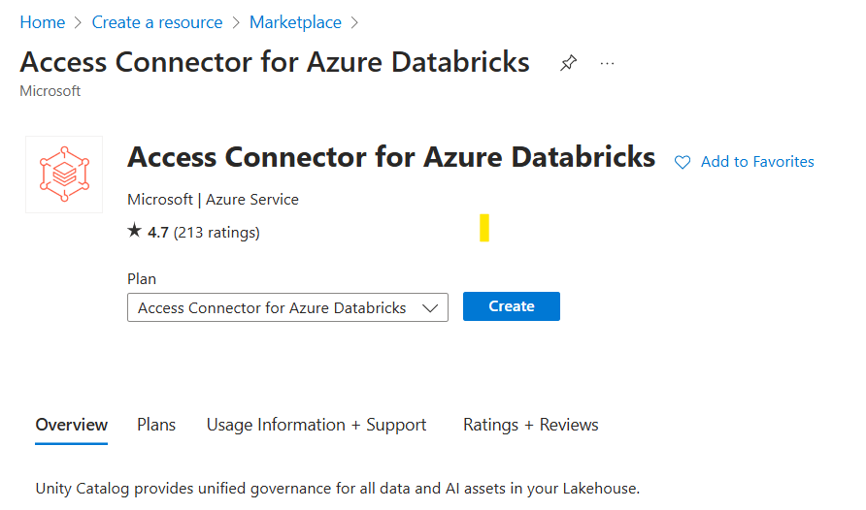
Steps
Create the databricks service in premium tier -> databricks1234
Create storage account for ADLS2 ->staccrgen2
Create service for access connector for Azure Databricks -> db_uc_access

Slide 33
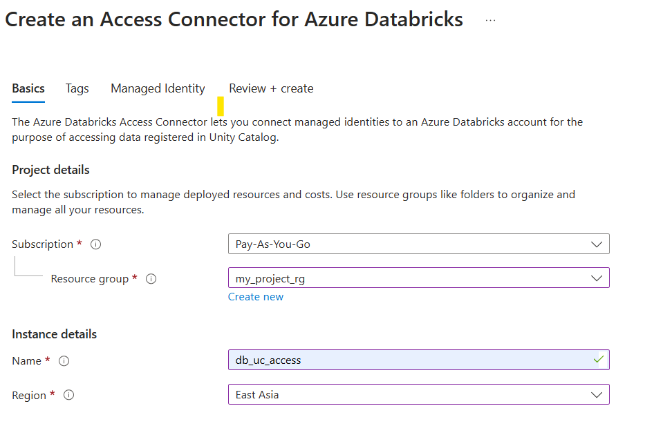
Create
Click on review+create
Go to the storge account stacctgen2
Go to IAM -> role assignment
Search for storage blob data contributer
Members -> Managed Identity

Slide 34
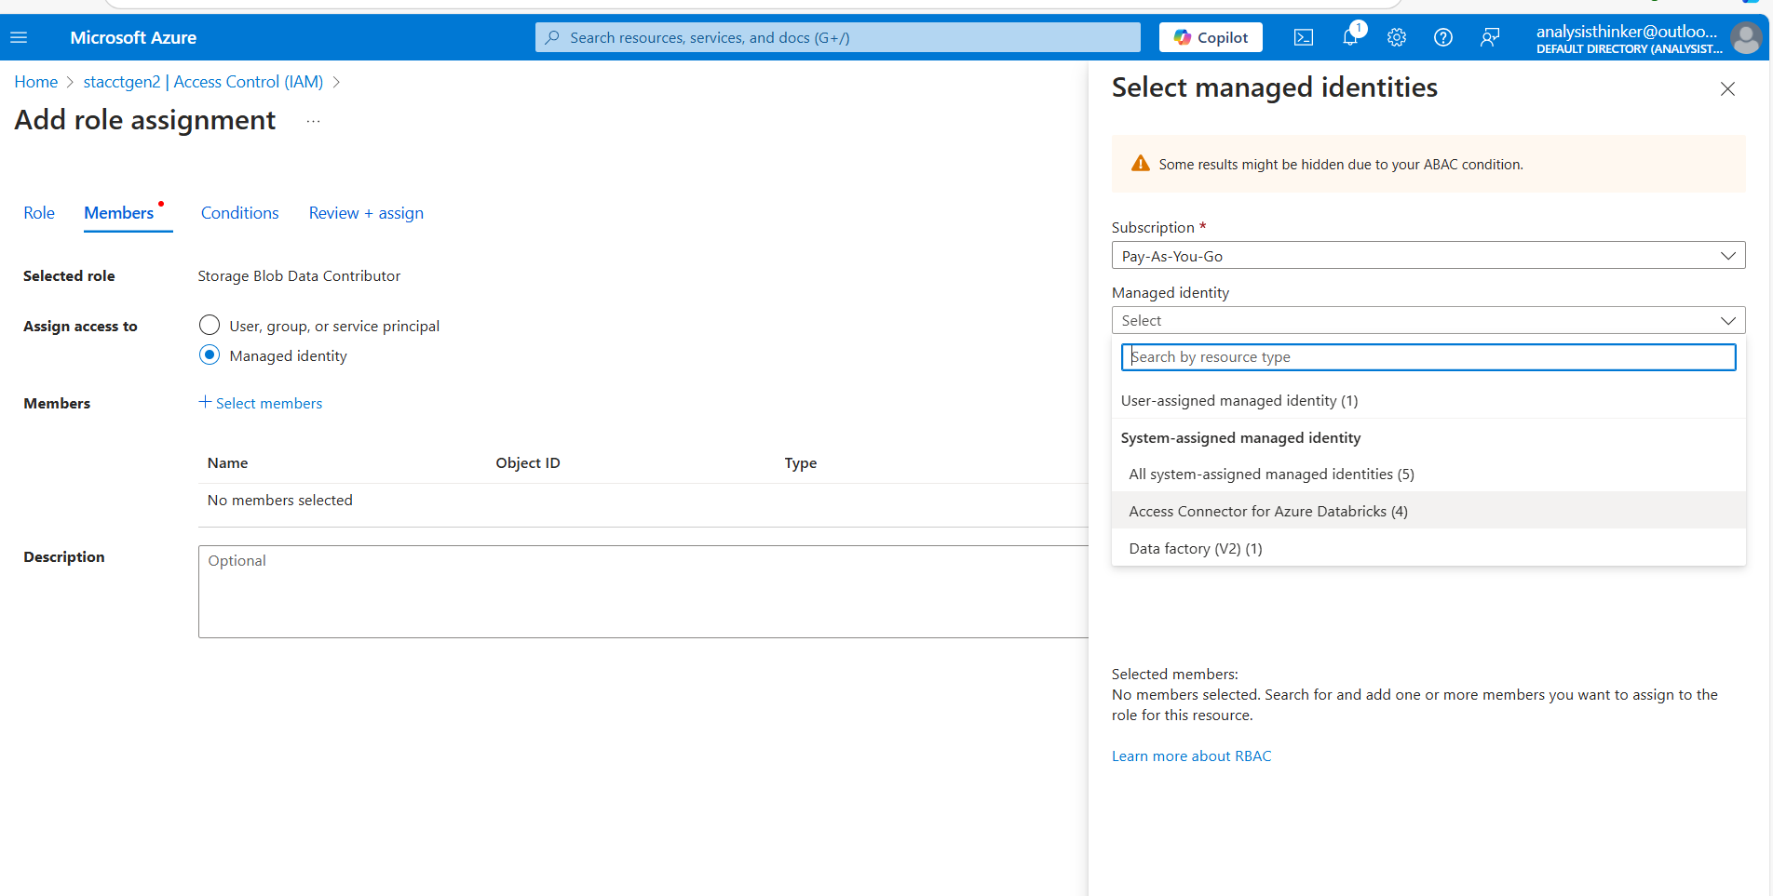
Assigning role

Slide 35
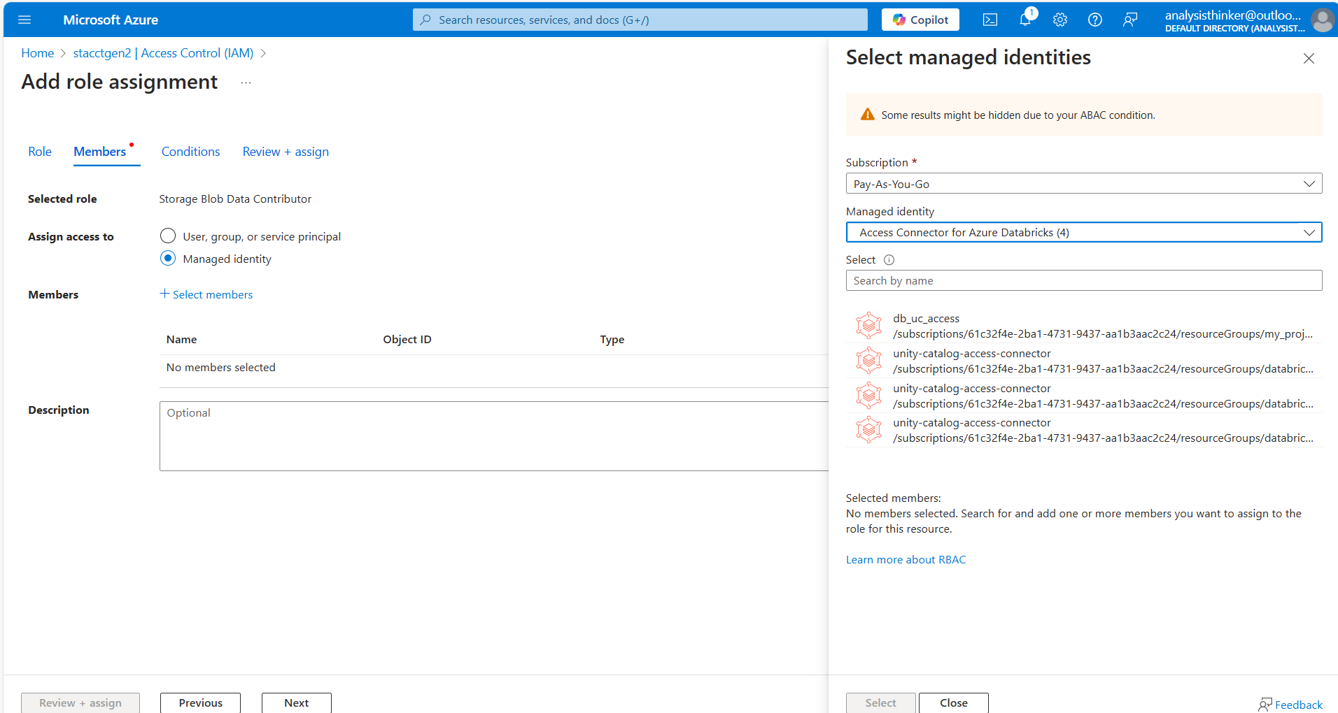
Select managed identities
Select db_uc_access
Review+ Create
Once this is create launch the databricks workspace
Go to databricks source.

Slide 36
Databricks account consol
https://accounts.azuredatabricks.net/
Here to add external user

Slide 37
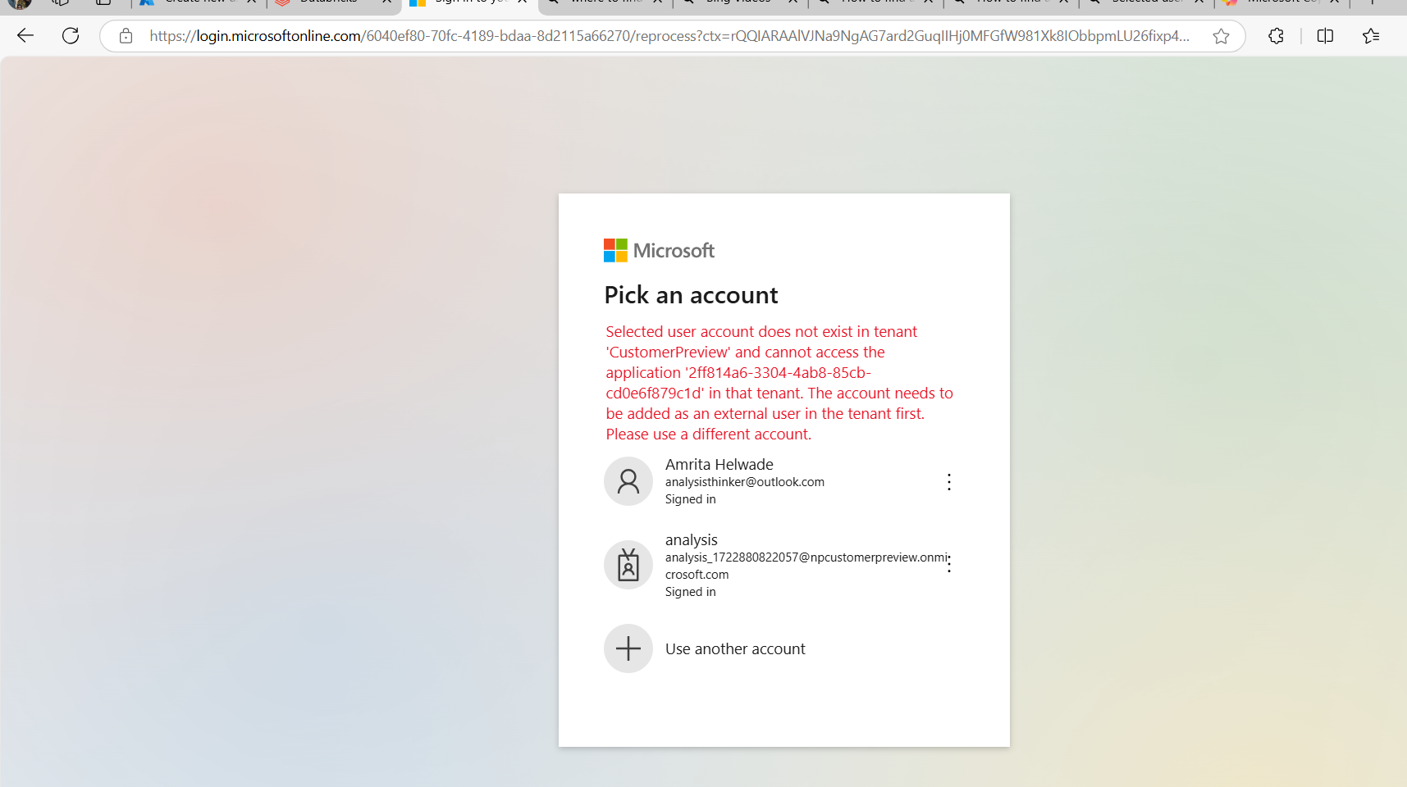
Access control in databricks
Check here for permissions to the workspaces.
To resolve this error follow the next steps

Slide 38
It looks like you’re encountering an issue where your user account isn’t recognized in the specified tenant. This typically happens when the account you’re using hasn’t been added as an external user in that tenant. Here are the steps to resolve this:
Add the User as a Guest:
Log in to the Azure portal with an account that has the necessary permissions.
Navigate to the Azure Active Directory blade.
Click on the Users blade.
Select New guest user and follow the prompts to add the user.
Accept the Invitation:
The user will receive an email invitation. They need to accept this invitation to be added as a guest user in the tenant.
Retry Access:
Once the user is added as a guest, they should be able to access the application.

Slide 39
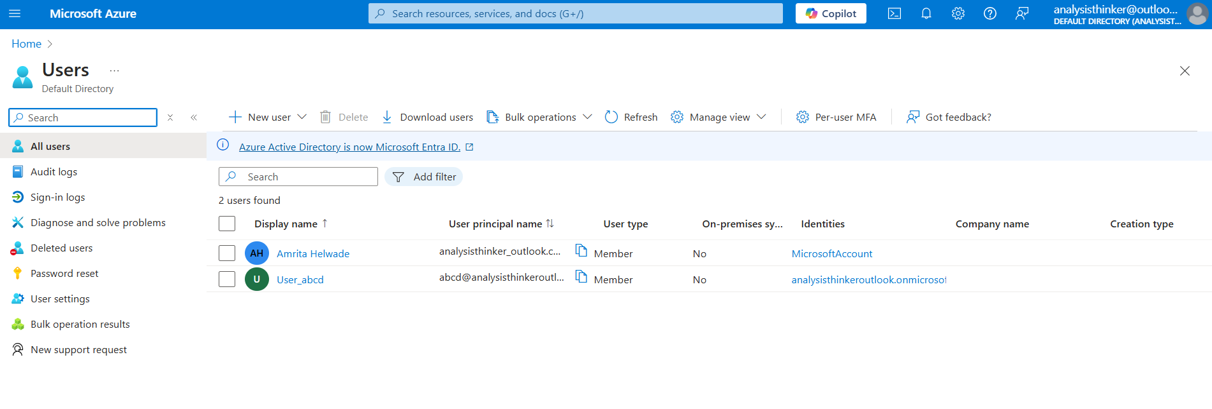
Add new user through Entra ID

Slide 40
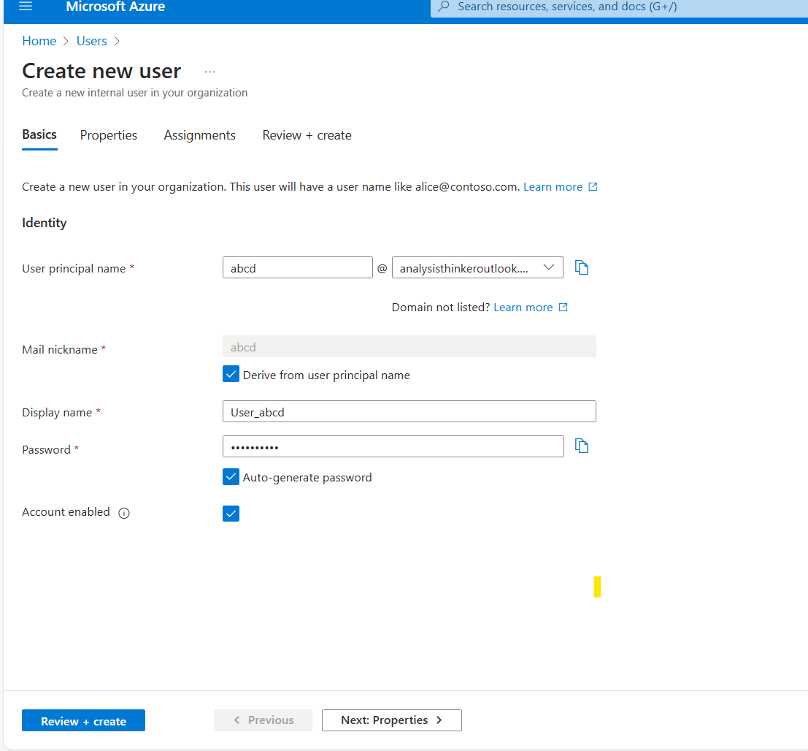
Copy user principal name
And password

Slide 41
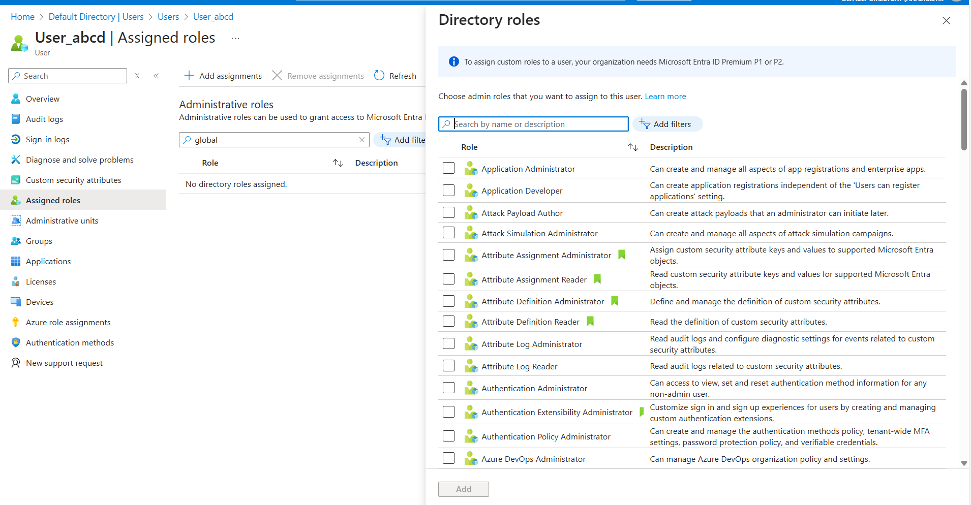
Go to role assignment and search for global administration

Slide 42
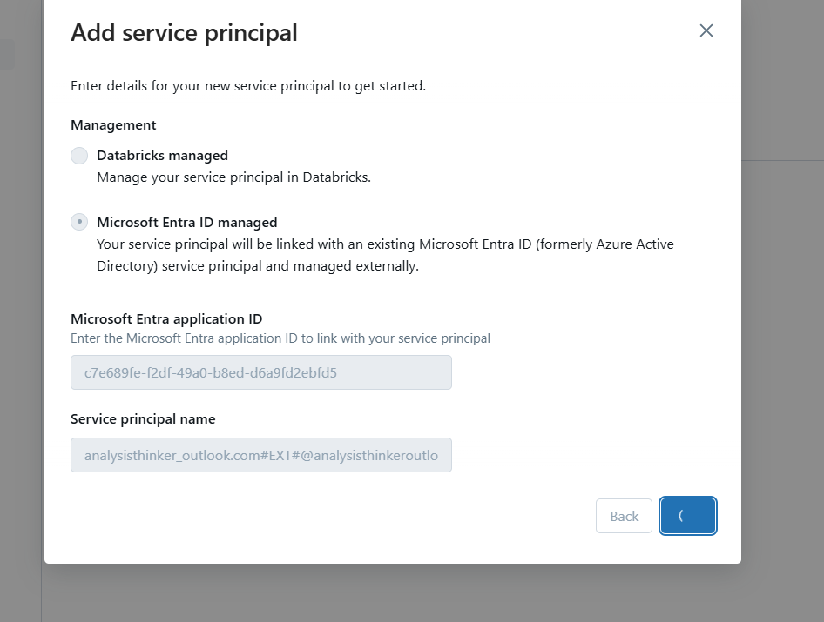
Go to databricks add the service principal and add the proper values
https://learn.microsoft.com/en-us/answers/questions/1373629/databricks-error

Slide 43
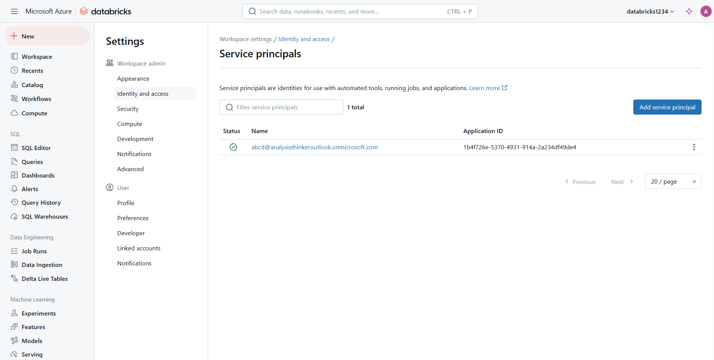

Slide 44
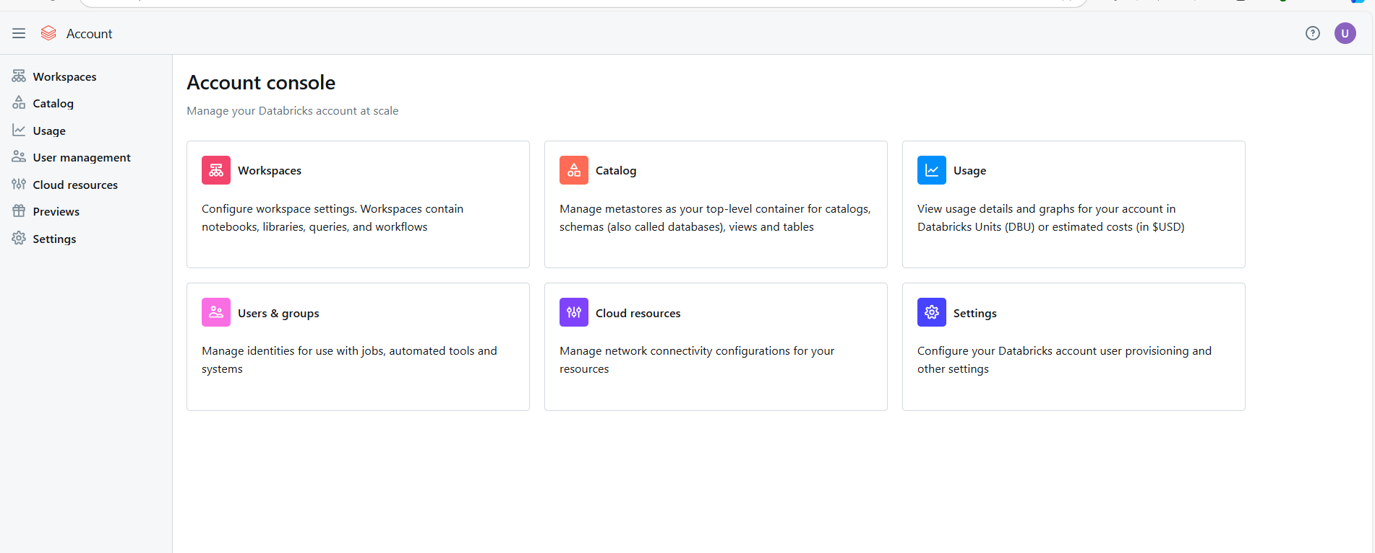
Moving to accounts console

Slide 45
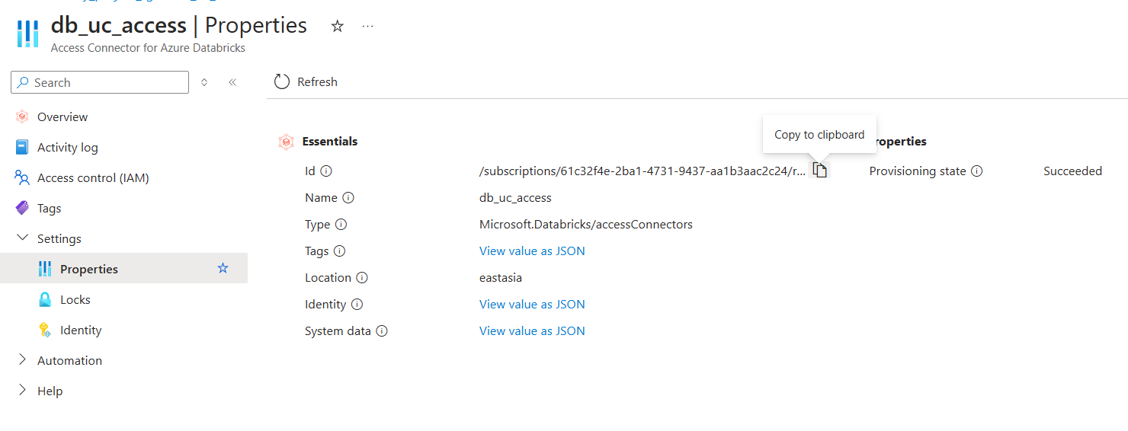
Copy access id
After passing the ID to metastore create the metastore.

Slide 46
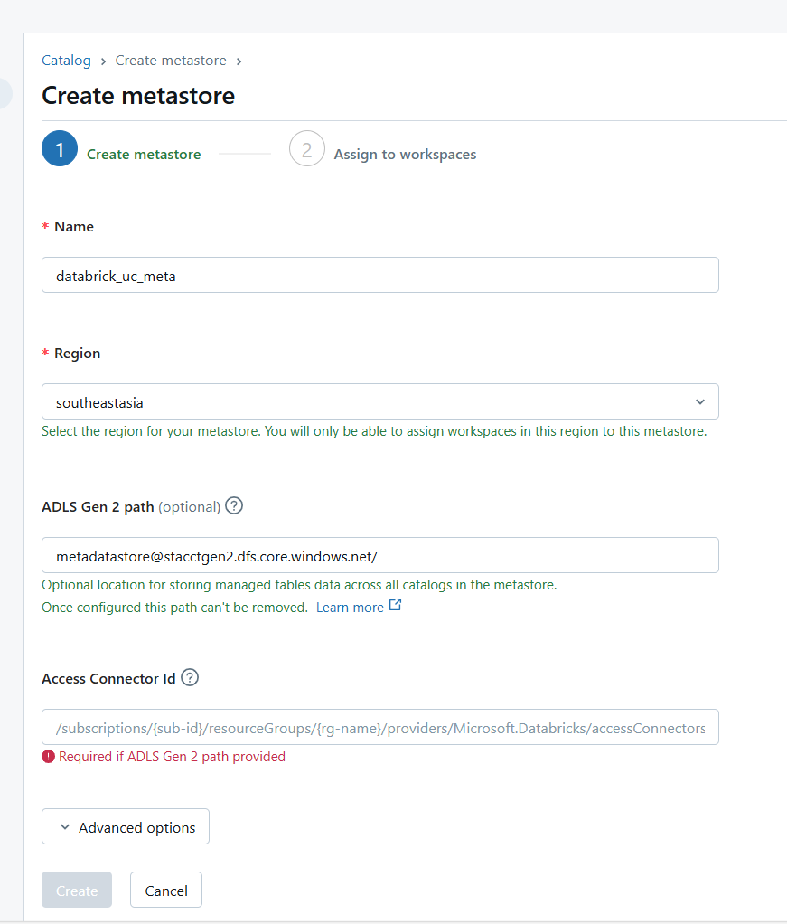
Create the metastore
Go to catlog and create metastore
Provide the name
Select the proper region
Pass the path to container having format as mentioned here:
container@storage.dfs.core.window.net
Pass the ID available in Unity catalog access

Slide 47
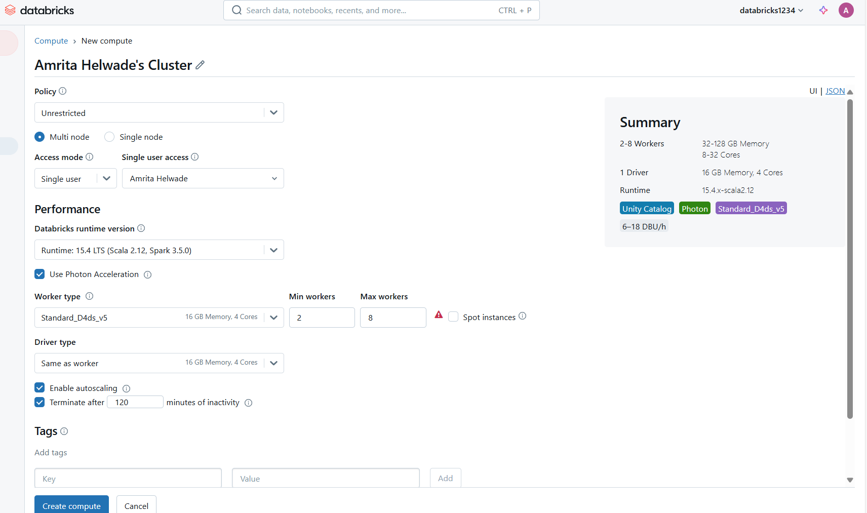
While creating cluster you may get here the unity catlog in summary
Databricks runtime: pick the version 11.3 onwards
Any node type more than 4 cores are sufficient.

Slide 48
Thank You

